Slide 1
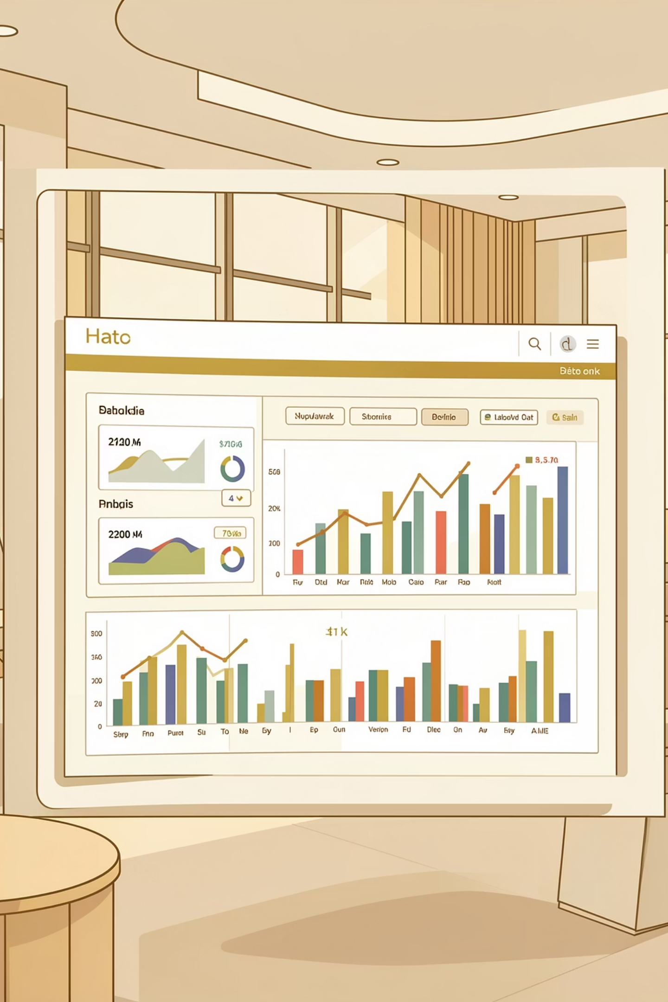
Customer Shopping Behavior Analysis
Uncovering insights from 3,900 purchases to drive strategic decisions

Slide 2

OVERVIEW
Project Scope
Analysis Goals
Spending patterns across demographics
Customer segmentation insights
Product preferences by category
Subscription behavior trends

Slide 3
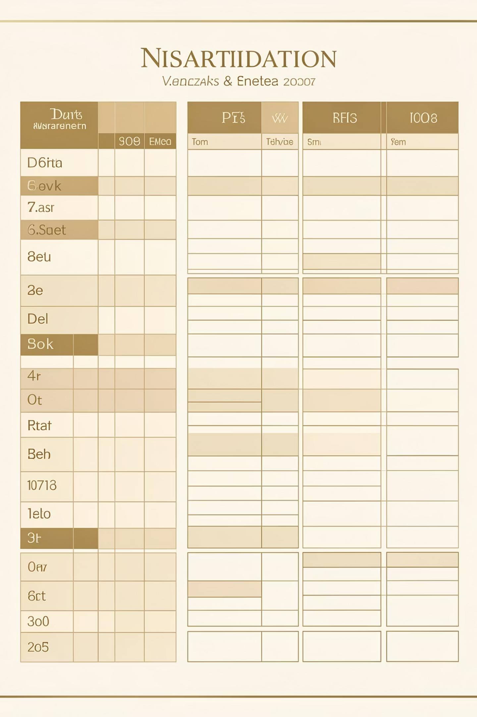
DATA FOUNDATION
Dataset Summary
3,900
18
$59.76
Total Purchases
Data Columns
Avg Purchase
Transactions analyzed
Feature dimensions
Per transaction
3.75
Avg Rating
Customer satisfaction

Slide 4

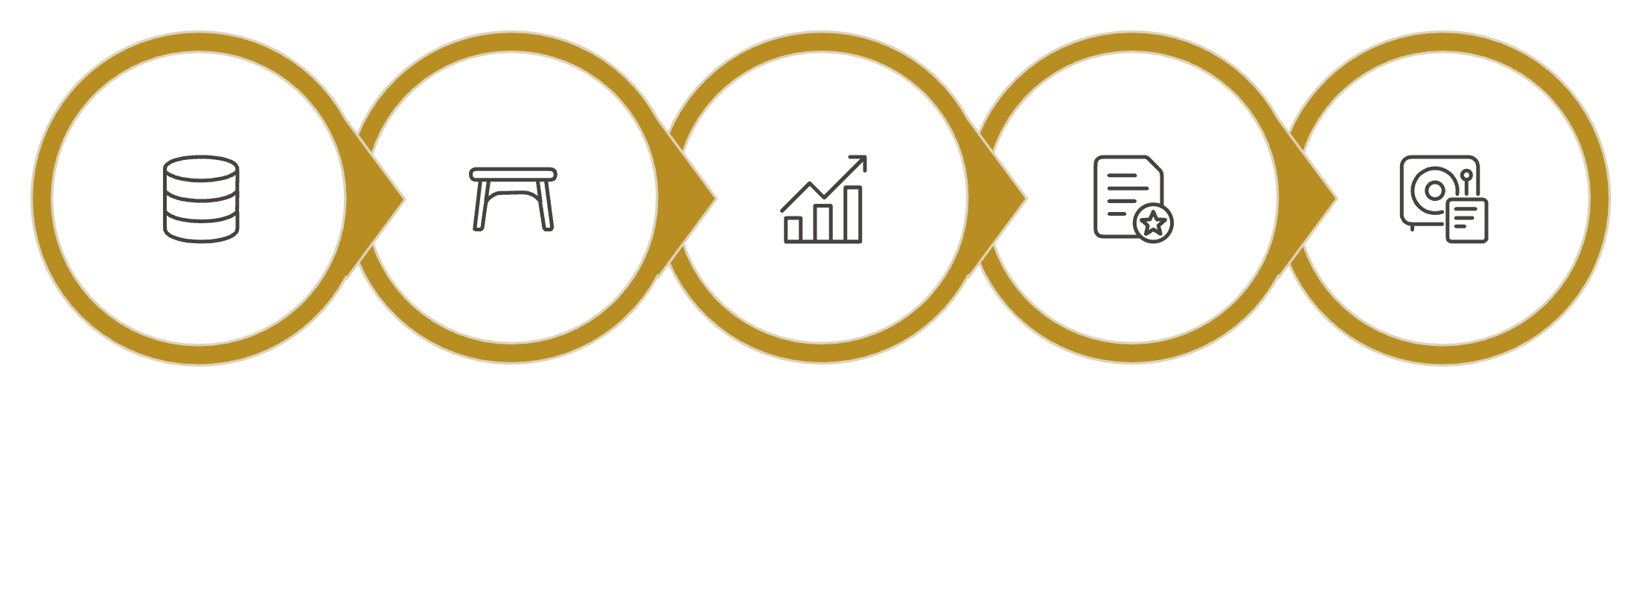
PYTHON
Data Preparation Process
Data Cleaning
Imputed 37 missing review ratings using category medians
Feature Engineering
Created age groups and purchase frequency metrics
Explore Structure
Handle Missing Values
Engineer Features
Export to Database
Load Data
Database Integration
Systematic approach to clean and prepare data for analysis
Connected to PostgreSQL for SQL analysis

Slide 5
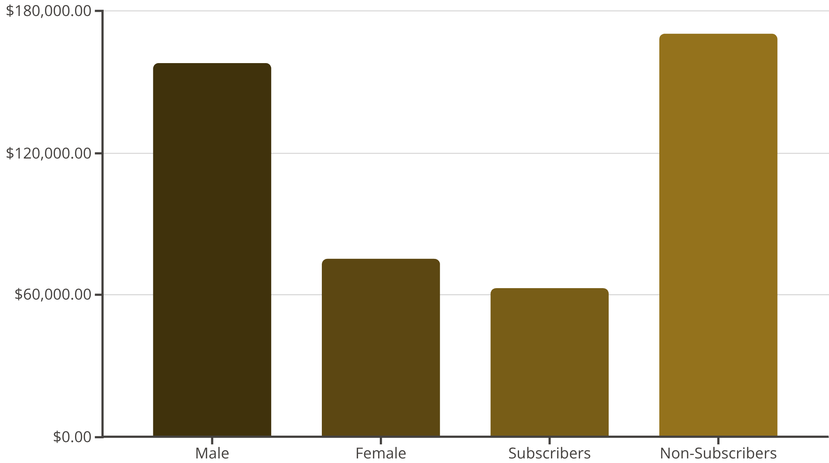
SQL ANALYSIS
Revenue Insights
Key Findings
Male customers generate 2x revenue of female customers
Non-subscribers represent 73% of total revenue despite lower engagement
Express shipping users spend $2 more on average than standard shipping

Slide 6



Customer Segmentation
Loyal Customers
Returning
New Customers
3,116 customers (80%)
701 customers (18%)
83 customers (2%)
Highest lifetime value
Growth opportunity
Conversion focus

Slide 7


PRODUCT PERFORMANCE
Top Products & Categories
Highest Rated Products
3.86
3.84
3.82
Gloves
Sandals
Boots
Revenue by Category
Clothing: $100K (43%)
Accessories: $70K (30%)
Footwear: $30K (13%)
Outerwear: $20K (9%)

Slide 8
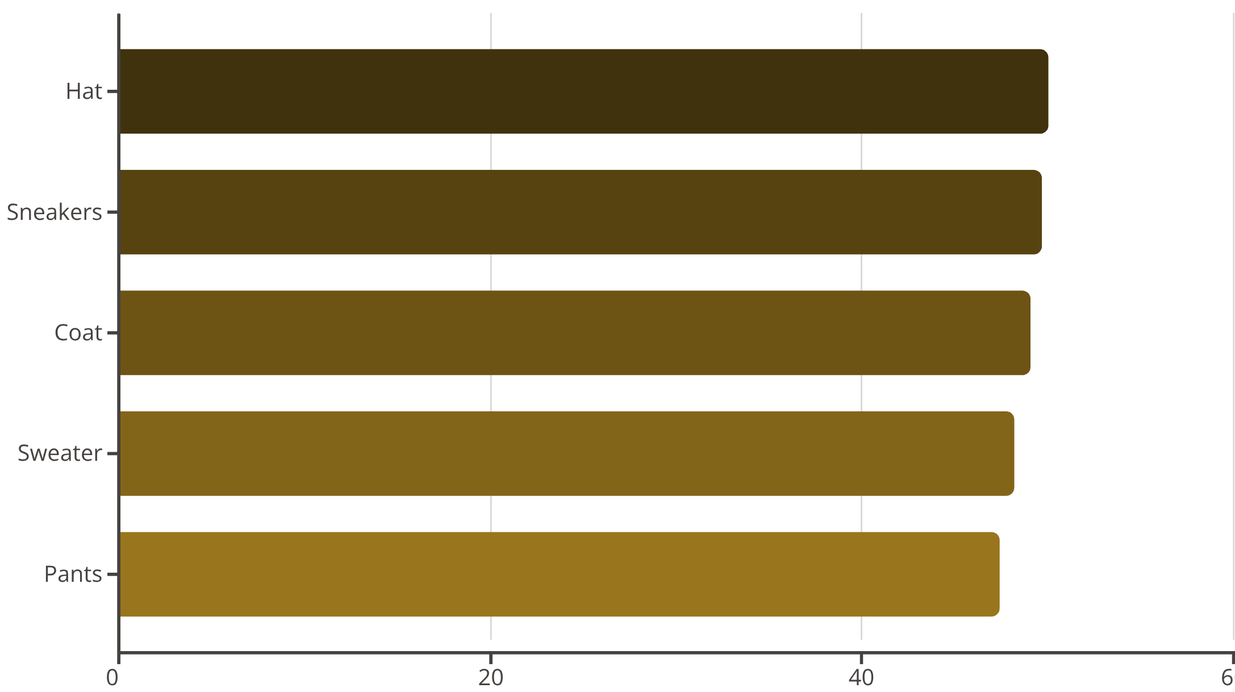
Discount Strategy Analysis
Smart Discount Users
839 customers used discounts but still spent above average
Opportunity to optimize discount thresholds without sacrificing revenue

Slide 9
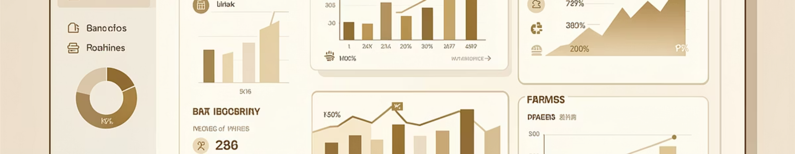
DASHBOARD
Power BI Dashboard Highlights
Subscription Status
Age Group Revenue
Interactive Filters
27% subscribed, 73% non-subscribed
Young adults lead with $45K
Gender, category, shipping type

Slide 10




ACTION ITEMS
Strategic Recommendations
Boost Subscriptions
Loyalty Programs
Promote exclusive benefits to convert 73% non-subscribers
Reward repeat buyers to grow loyal segment
Optimize Discounts
Targeted Marketing
Balance sales boosts with margin control
Focus on high-revenue age groups and express shipping users

